Slide 1
Work Resources and Workload Factors Survey
Information material for the workplace

Slide 2
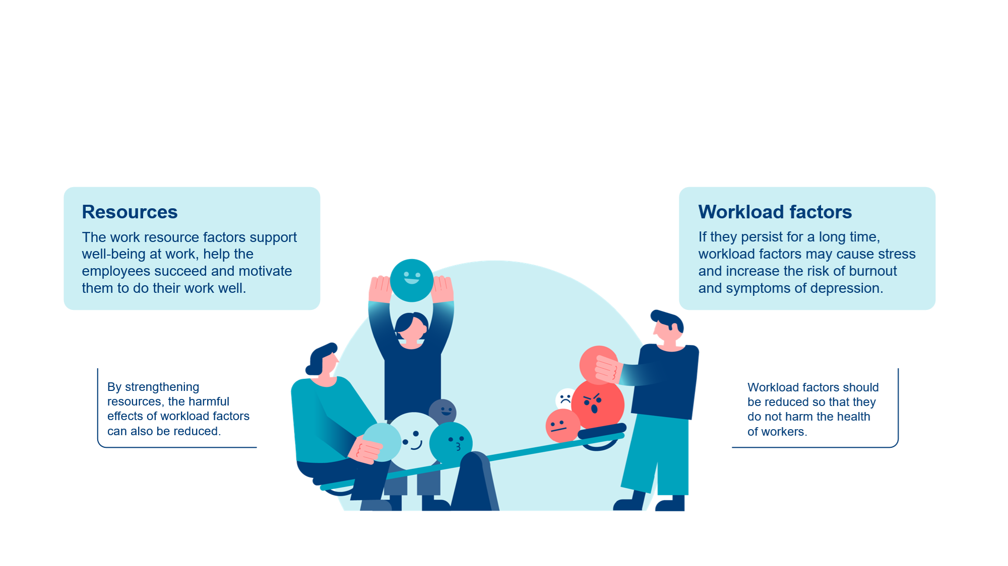
Well-being at work can be promoted in two ways
The aim of the Work Resources and Workload Factors survey is to gather the personnel’s experiences of work resources and workload factors in order to develop the work community.

Slide 3
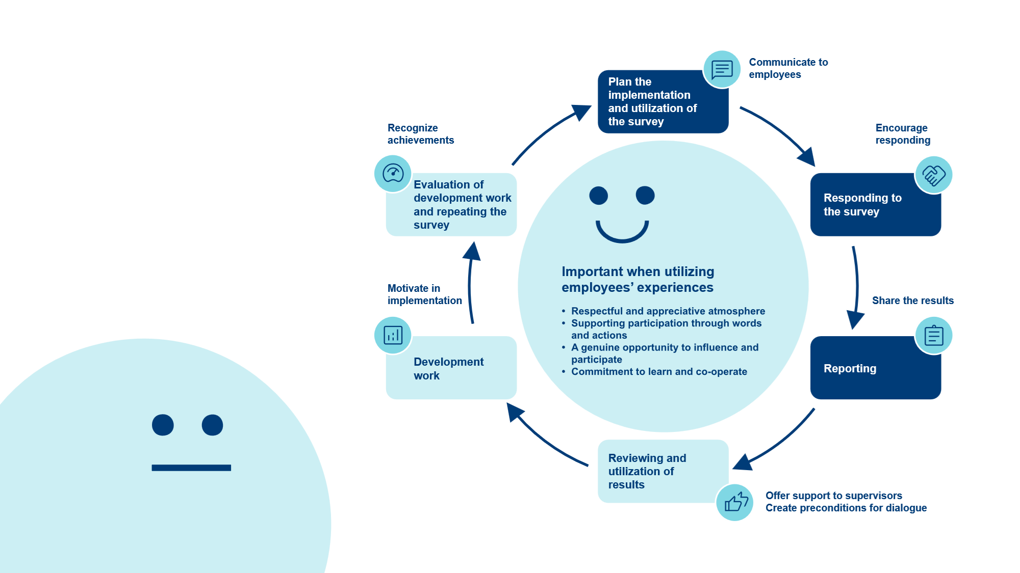
The survey is part of the evaluation and development of activities

Slide 4
Why and when will the survey be conducted?
The survey will help us identify the most important resources and the most significant workload factors of our work community in order to strengthen our resources and reduce and manage the workload factors.
Responding to the survey
The response time for the survey is 2 weeks: [enter the time dates here]
You will receive a link to the survey by email [specify from whose address]
Responding takes about 10 minutes
Reserve time for responding to the survey, everyone’s view is important!
Reporting and reviewing the results
The reports will be distributed to supervisors and teams [enter the schedule]
The results will be reviewed in teams [enter the schedules or instructions on how to agree them]
[Enter information on which different parties will utilize the results and when: e.g., management, occupational safety organization, occupational health care, etc.]

Slide 5
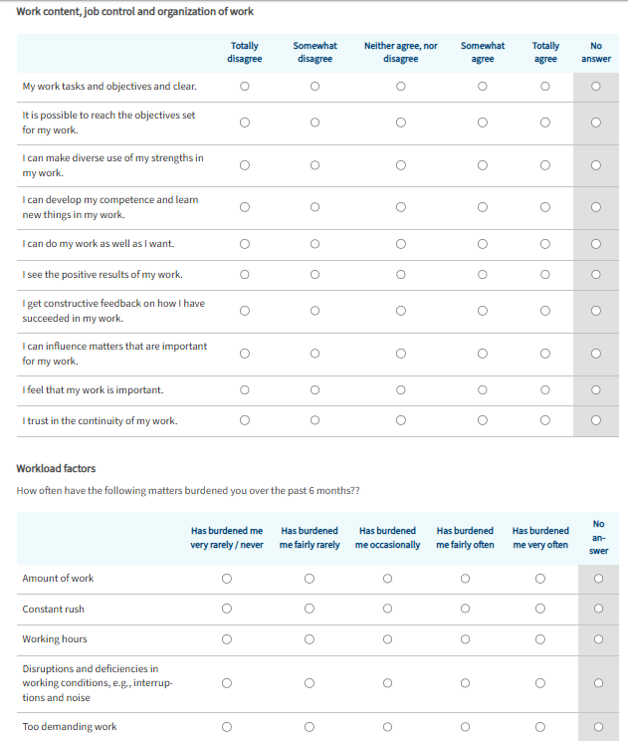
Survey content
Work content, job control and organization of work
Clarity of work tasks and objectives, use and development of competence, feedback, opportunities to influence, trust in continuity of work
Workload factors
The most common workload factors, work-related stress and recovery
Supervisory work and management
Showing appreciation, providing support and help, trust, listening to opinions, flow of information, taking care of well-being at work
Functioning of the work community
Division of work, ground rules, flow of information and interaction, cooperation, support and assistance, appreciation, working climate
Workplace practices
Evaluation and development of operations, preparedness for changes, fair treatment and work-life balance
Job satisfaction
Work engagement, job satisfaction and willingness to recommend the employer

Slide 6
Confidentiality
Confidentiality of responding
Responding is voluntary and takes place anonymously.
The data will be collected using the electronic survey platform of a partner (Data Rangers Oy) of the Finnish Institute of Occupational Health.
No e-mail address or IP address is stored in the response data.
The answers are recorded through a secure connection (SSL).
Confidentiality of reporting
Individual answers or the data collected from them will not be disclosed to the workplace.
The responses will be reported as averages at the group level (at least 5 responses per group) and at the level of the whole organization.
The answers given by individual respondents cannot be identified from the reported results.

Slide 7
Why should I respond?
Everyone can evaluate
Everyone’s opinion is important
Recognizing different experiences
Please answer honestly. That's the only way we can get a reliable overview of the situation
It is possible to influence matters
The results of the survey will be reviewed, and they will serve as a basis for agreeing on the development measures

Slide 8
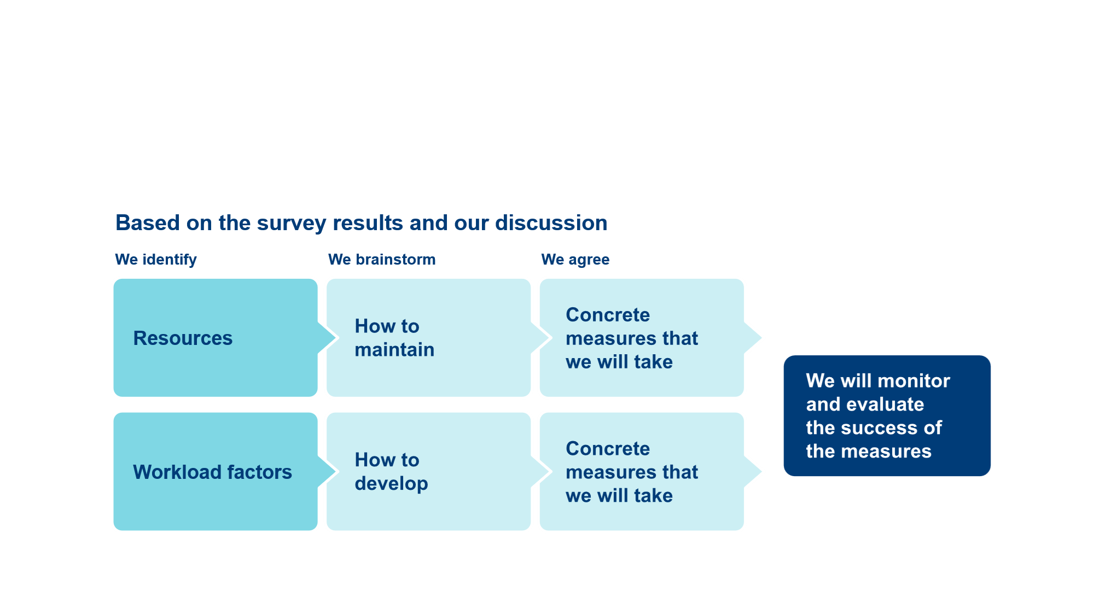
Reviewing and utilizing results in groups
Groups will agree a time for reviewing the survey results of their own group together. Instructions for discussing the results can be found in the report

Slide 9
Matters requiring development and making decisions concerning them
It is advisable to collect ideas concerning the whole workplace from the teams and process them together.
In matters concerning cooperation between teams, present the ideas to the teams that you work in cooperation with and agree on how to promote the matter together.
In matters concerning your own team, agree on the matters within the team.
Matters concerning
the whole workplace
Matters concerning
the cooperation
between teams or departments
Matters
concerning the team
that can be decided
by the team

